Slide 1
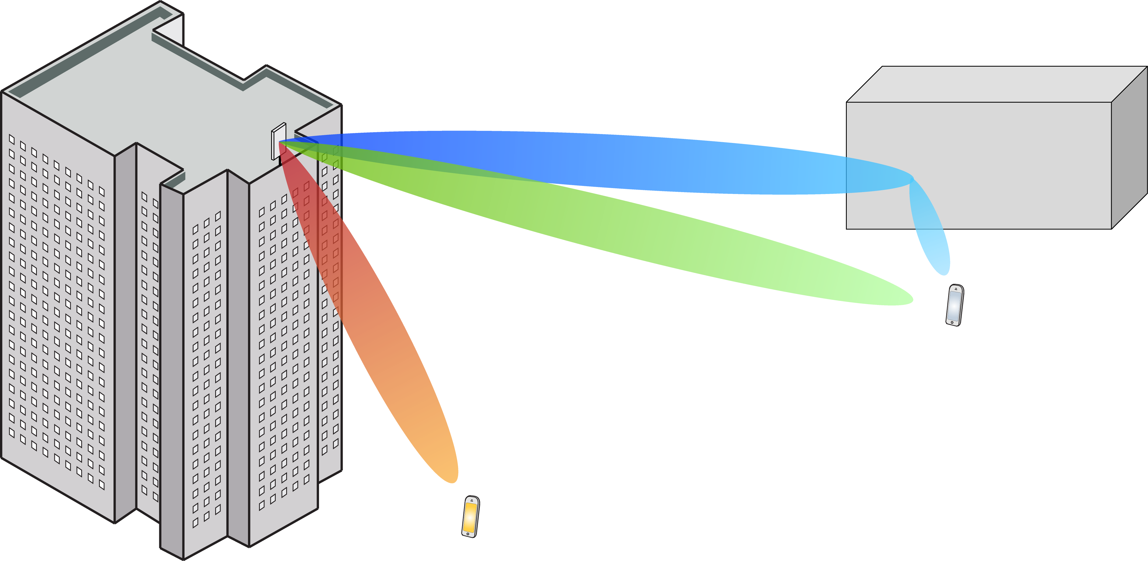
Multiple Antenna Communications
Lecture 1:
Motivation for Multiple Antenna Communications
Emil Björnson

Slide 2
Outline
Capacity dependence on power and bandwidth
Basic wave propagation and antennas
Frequency bands
Three ways that multiple antennas improve wireless communications

Slide 3
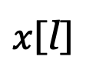
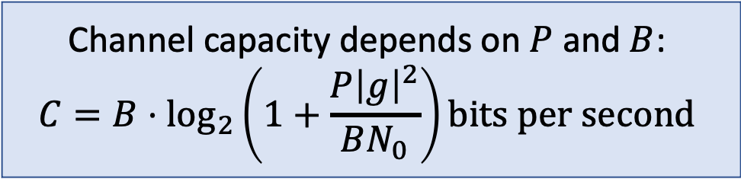
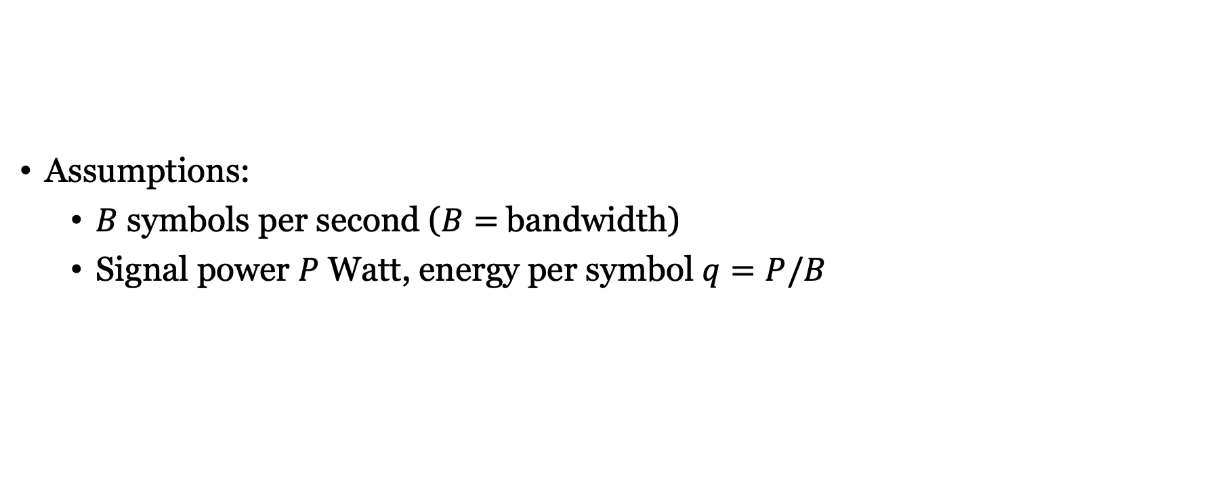
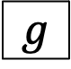
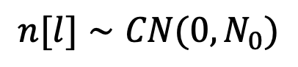
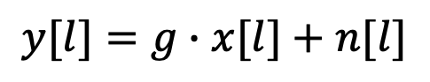
Discrete memoryless channel
$$n[l]∼CN(0,N_{0})$$
Assumptions:
$B$ symbols per second ($B=$bandwidth)
Signal power $P$ Watt, energy per symbol $q=P/B$
$x$[l]
$$g$$
+
$$y[l]=g∙x[l]+n[l]$$
Channel capacity depends on $P$ and $B$:
$$C=B⋅\log_{2}\left(1+\frac{P{\left|g\right|}^{2}}{BN_{0}}\right)bits per second$$

Slide 4
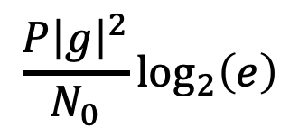
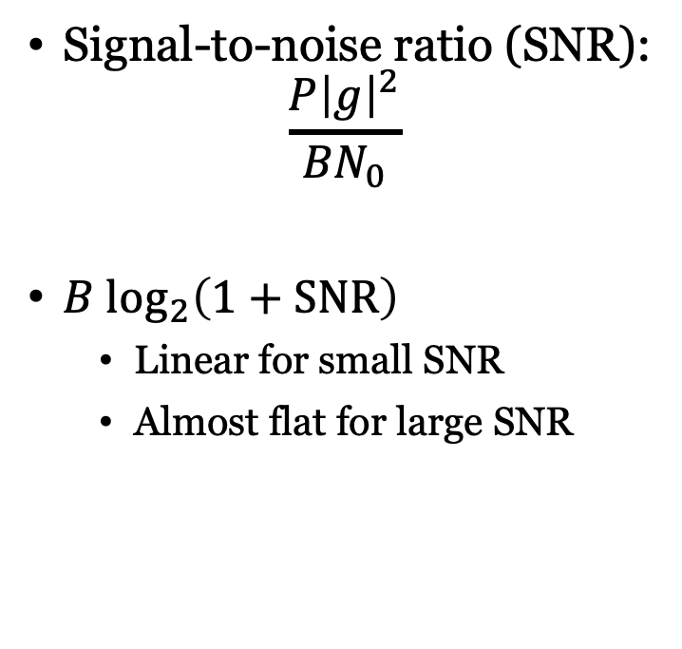
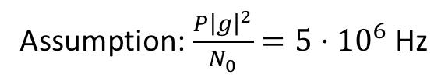
Capacity behaviors
$$\frac{P{\left|g\right|}^{2}}{N_{0}}\log_{2}\left(e\right)$$
Signal-to-noise ratio (SNR):
$$\frac{P{\left|g\right|}^{2}}{{BN}_{0}}$$
${B log}_{2}\left(1+SNR\right)$
Linear for small SNR
Almost flat for large SNR
Power limited region
Bandwidth
limited
region
Assumption: $\frac{P{\left|g\right|}^{2}}{N_{0}}=5⋅{10}^{6}$ Hz

Slide 5
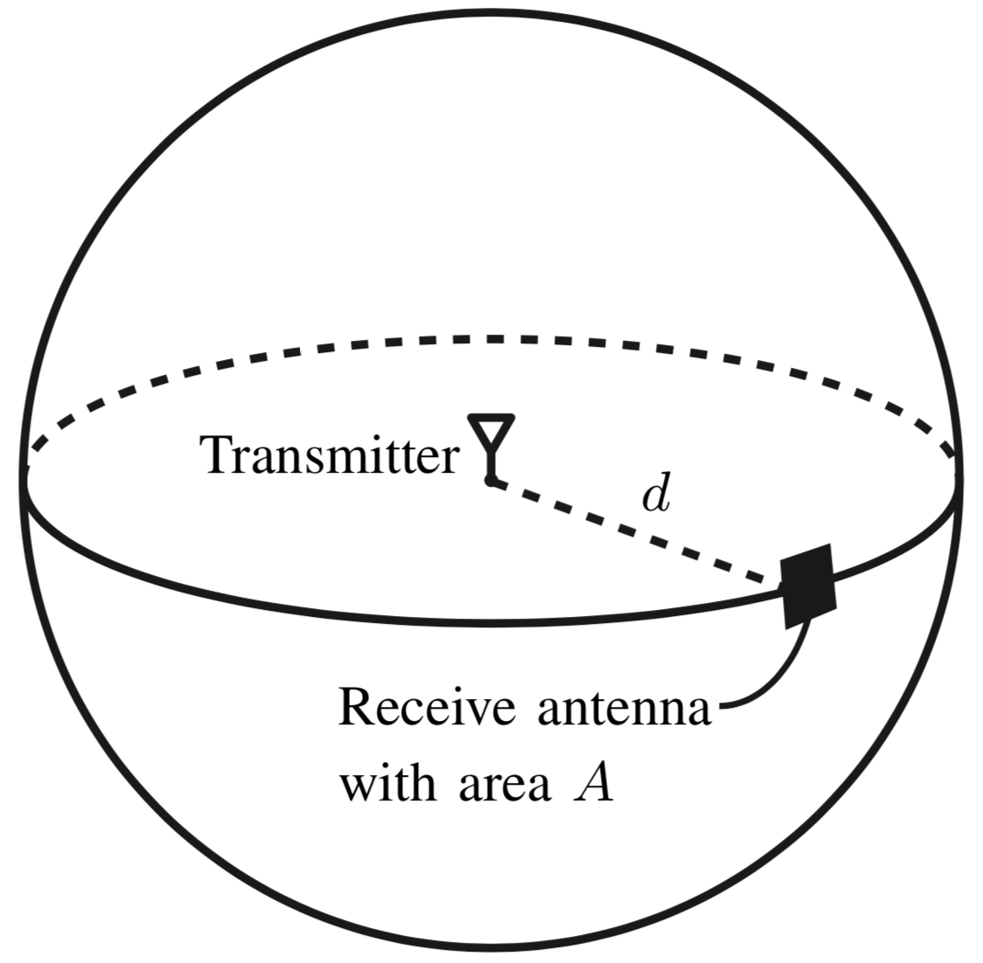
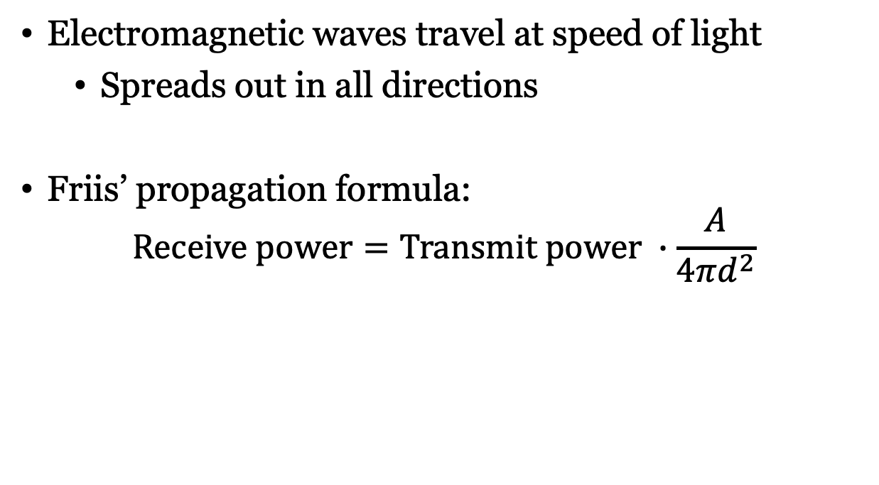
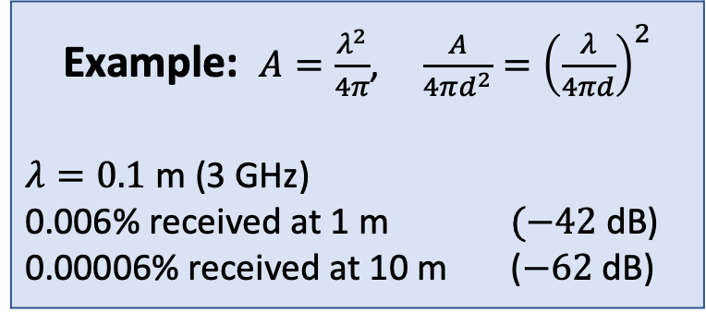
Basic wave propagation
Electromagnetic waves travel at speed of light
Spreads out in all directions
Friis’ propagation formula:
$$Receive power=Transmit power ∙\frac{A}{4πd^{2}}$$
Example: $A=\frac{λ^{2}}{4π}$, $\frac{A}{4πd^{2}}={\left(\frac{λ}{4πd}\right)}^{2}$
$λ=0.1$ m (3 GHz)
0.006% received at 1 m $(−42$dB)
0.00006% received at 10 m ($−62$dB)
Only a tiny fraction of transmit power is received!

Slide 6
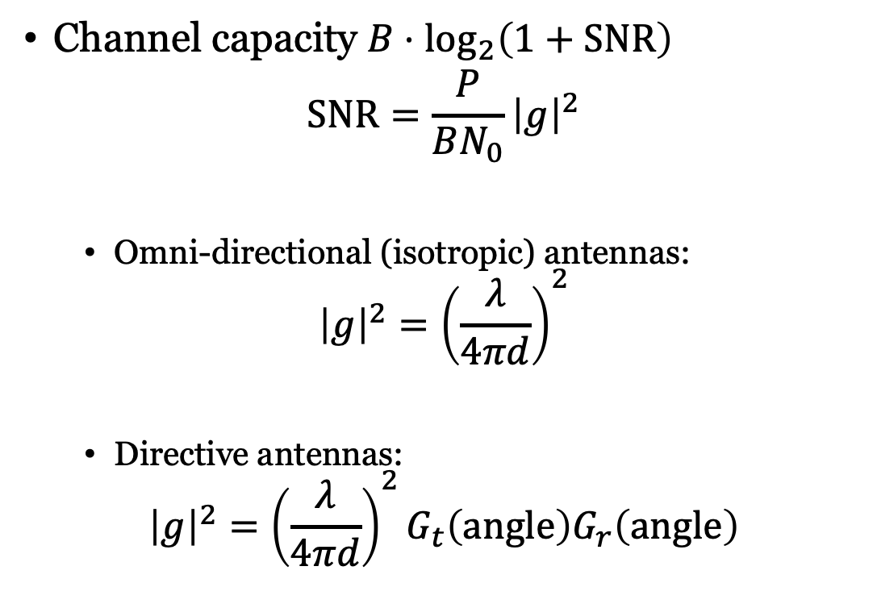
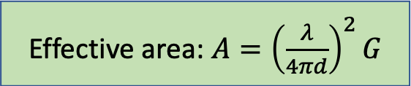
Different types of antennas
Example:
Channel capacity $B⋅\log_{2}\left(1+SNR\right)$
$$SNR=\frac{P}{BN_{0}}{\left|g\right|}^{2}$$
Omni-directional (isotropic) antennas:
$${\left|g\right|}^{2}={\left(\frac{λ}{4πd}\right)}^{2}$$
Directive antennas:
$${\left|g\right|}^{2}={\left(\frac{λ}{4πd}\right)}^{2}G_{t}\left(angle\right)G_{r}\left(angle\right)$$
[dBi]
Effective area: $A={\left(\frac{λ}{4πd}\right)}^{2}G$
to receiver
to transmitter

Slide 7
Frequency spectrum in wireless communications
Traditional
Limited bandwidth
Large wavelengths
mmWave (above 28 GHz)
Large bandwidth
Small wavelength
Low-band
(below 1 GHz)
Mid-band
(1-7 GHz)
High-band
(above 7 GHz)
Approximate size of an isotropic antenna
Low-band (800 MHz): 1 dm x 1 dm
Mid-band (3 GHz): 3 cm x 3 cm
High-band (30 GHz): 3 mm x 3 mm
Directive antennas
in fixed infrastructure
Directive antennas
also in handheld devices

Slide 8
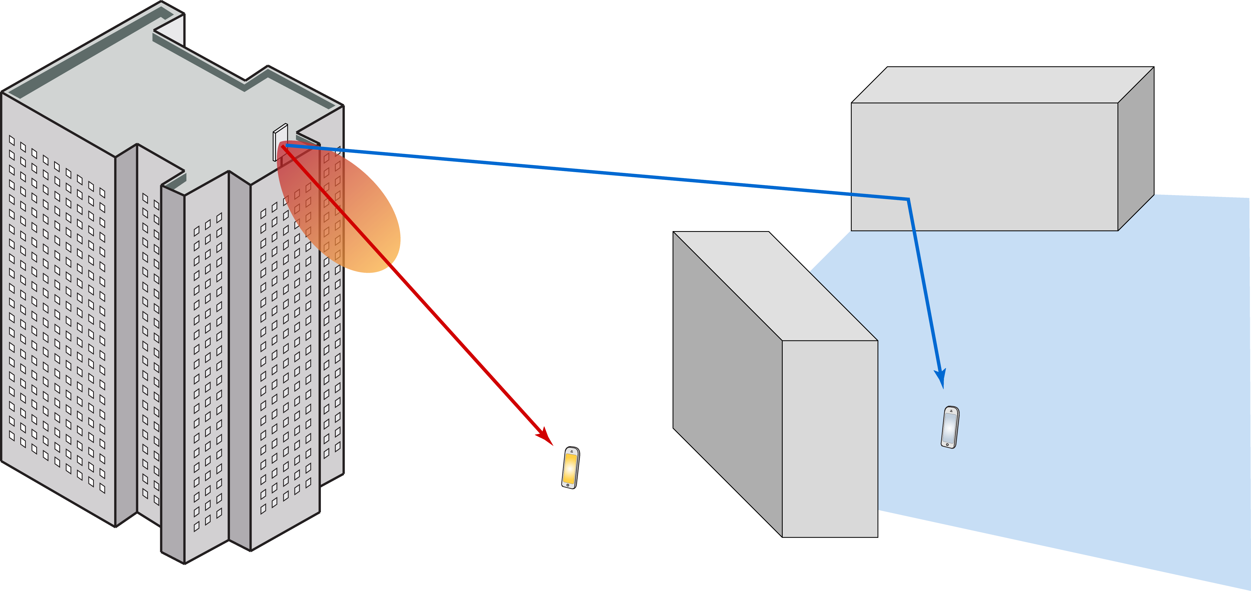
Mobile wireless communications
Directive antenna not useful in handset:
Unlucky user
Disadvantage from directivity
Lucky user
Advantage from directivity
We want adaptive directivity!

Slide 9
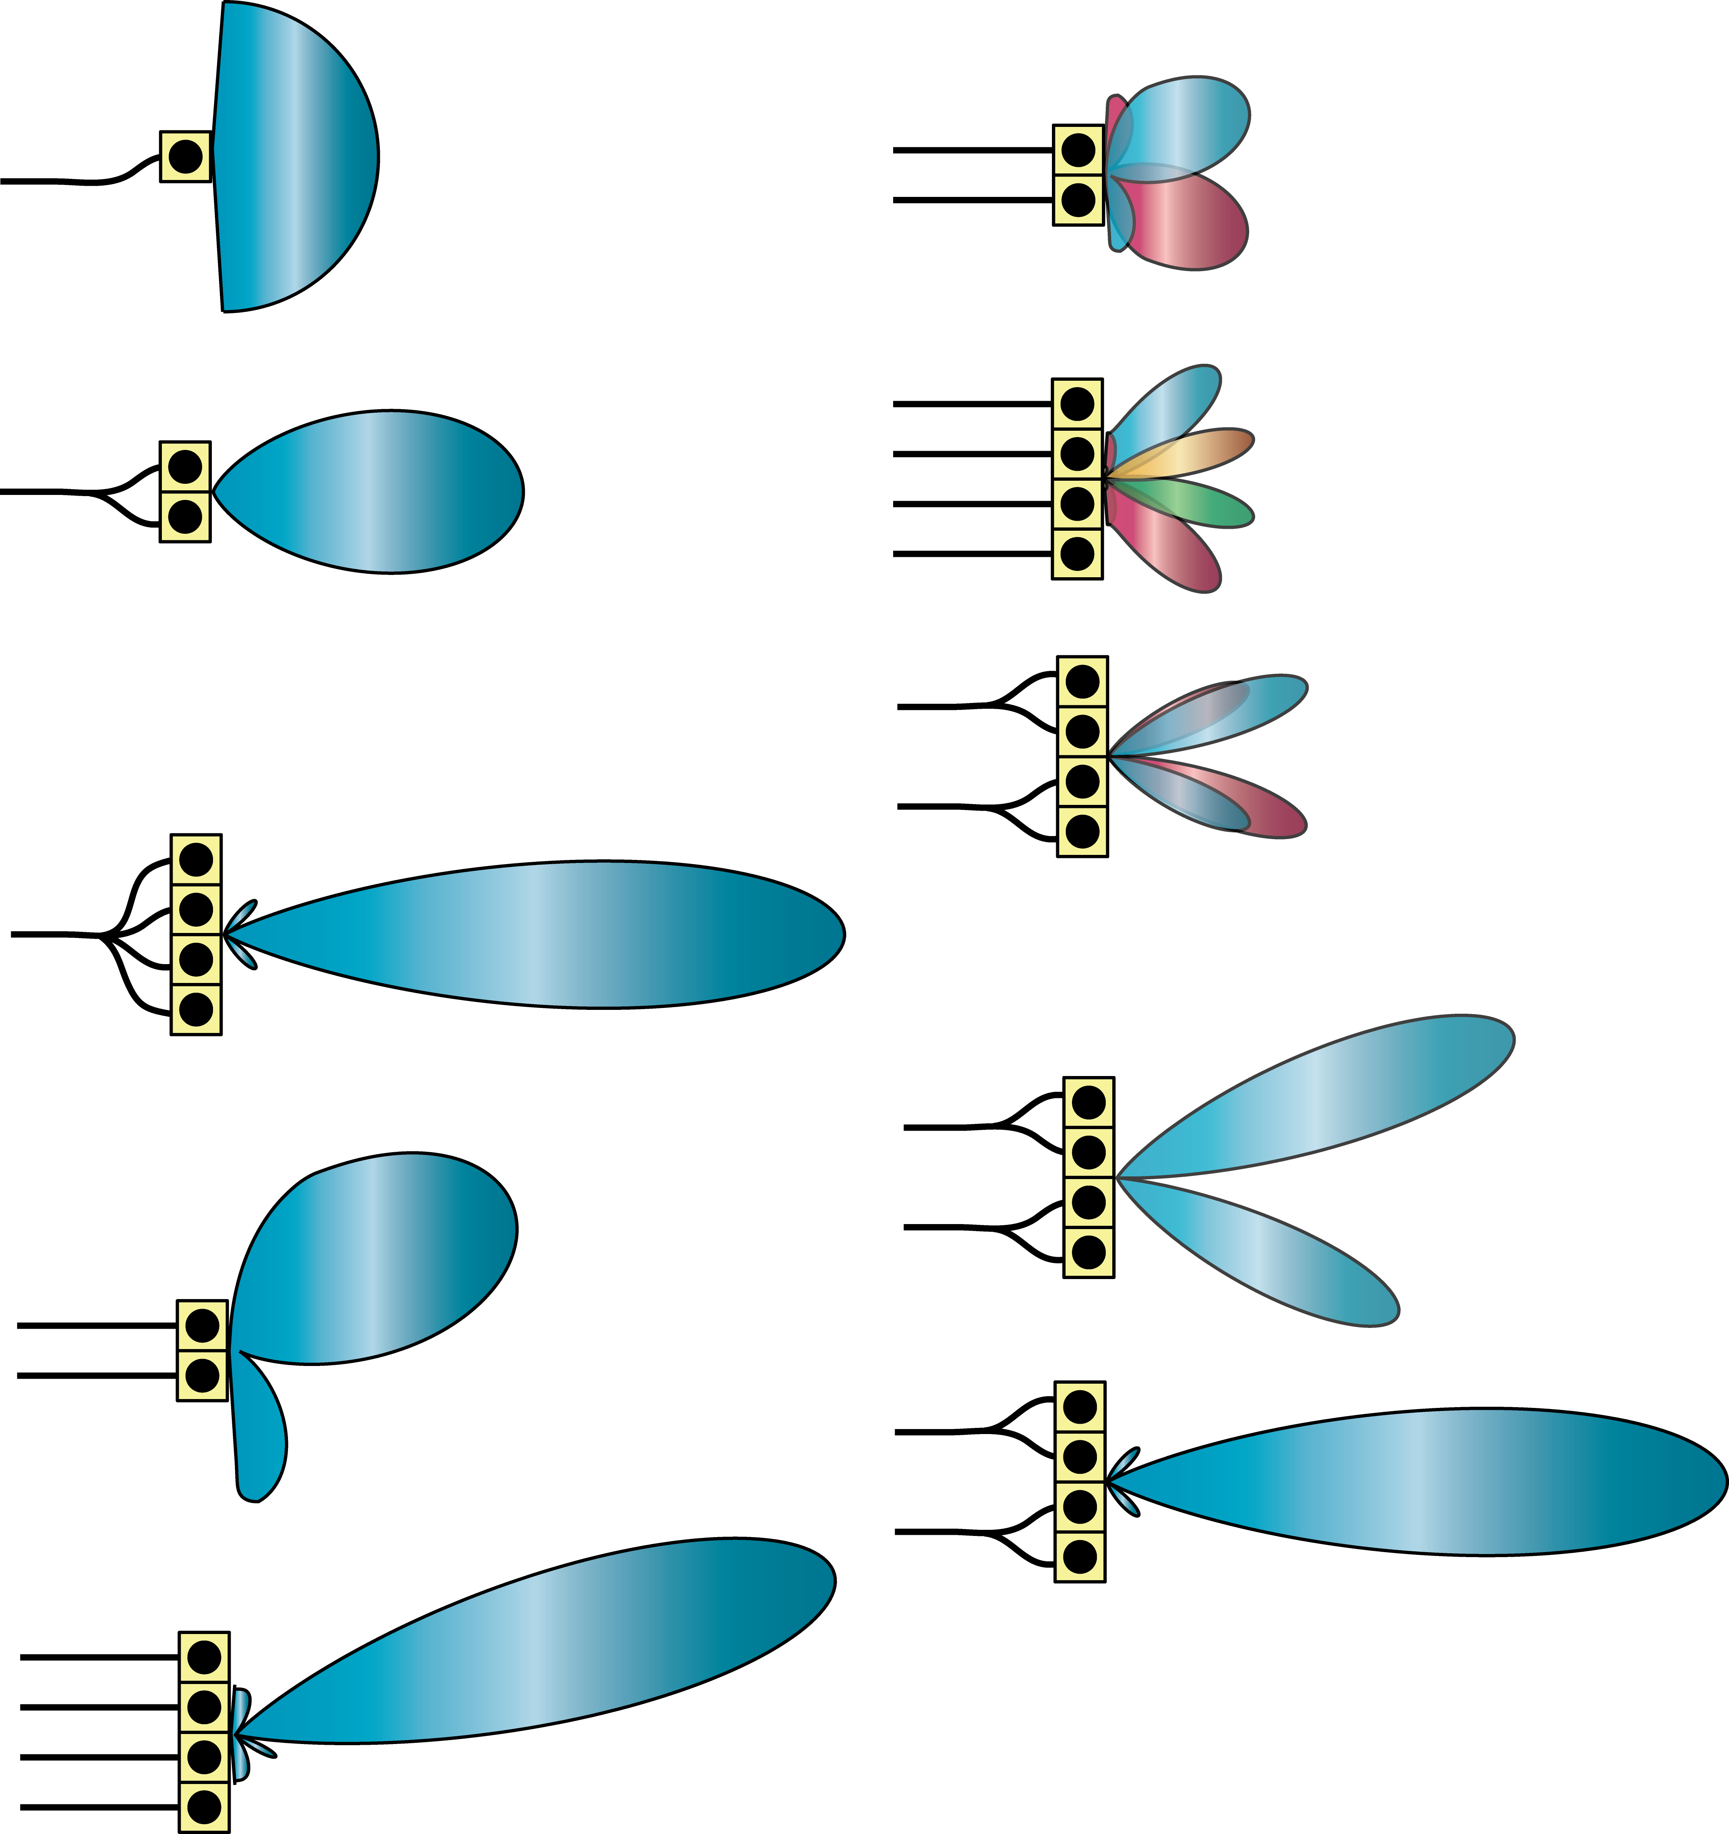
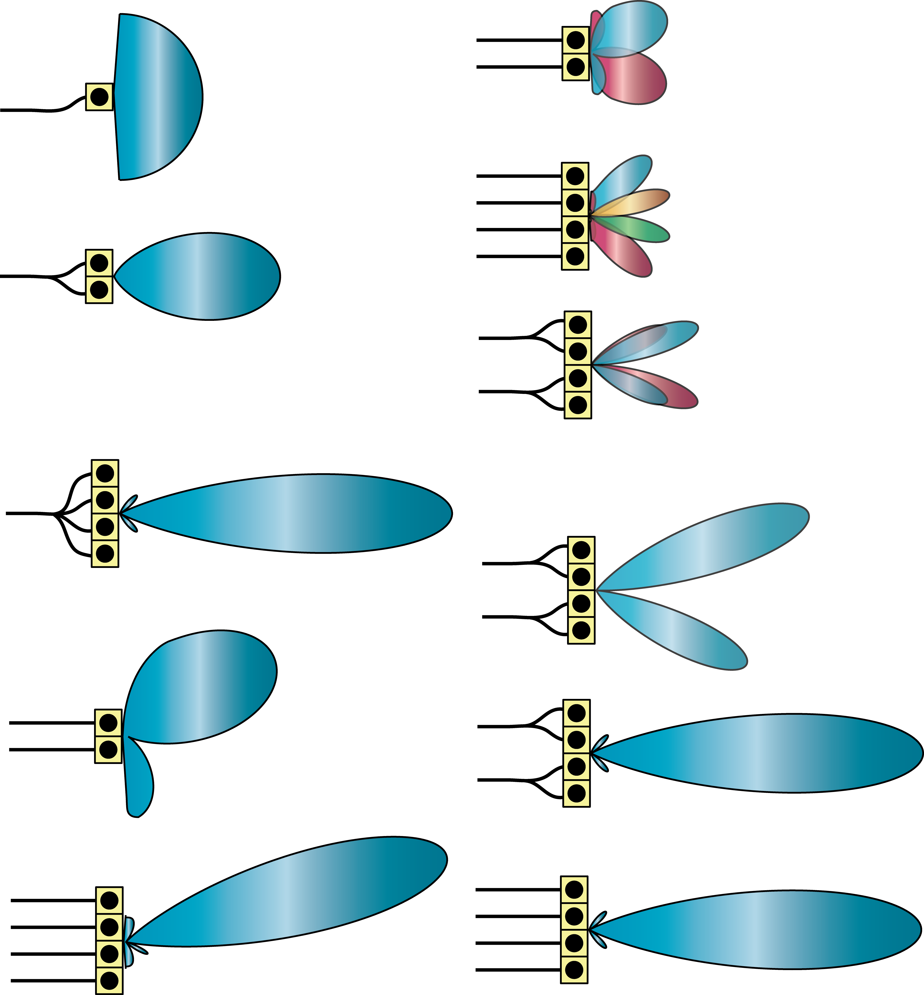
How can we adapt directivity?
Constructive interference
Constructive interference
One antenna
Two antennas
(same signal, different delays)
Two antennas
(same signal)

Slide 10
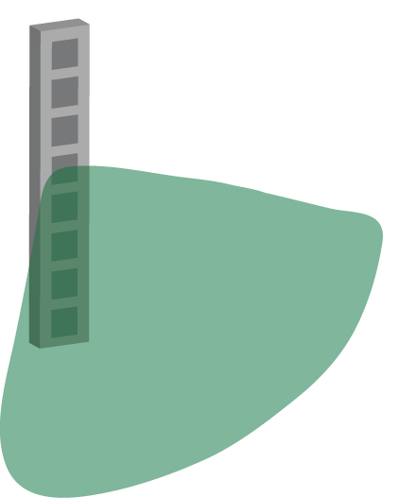
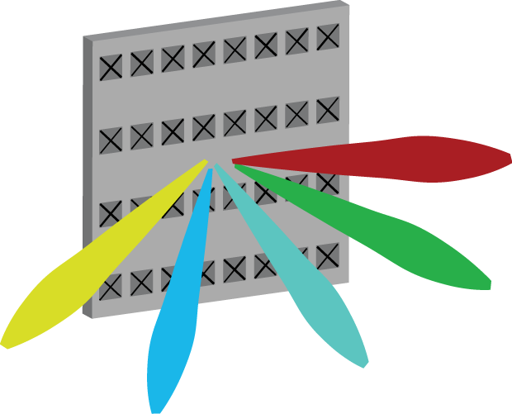
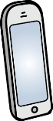
From passive antennas to active antenna arrays
1 strongly directive antenna
64 weakly directive antennas
Passive antenna
Constant directivity
Active antenna array
Antenna-integrated radios
Strong but adaptive directivity
Multiple directions at same time

Slide 11
Three main benefits of multiple antenna communications
Beamforming gain
Spatial diversity
Spatial multiplexing
The course will cover all of them:
First historical perspective
Then the theory behind them

Slide 12
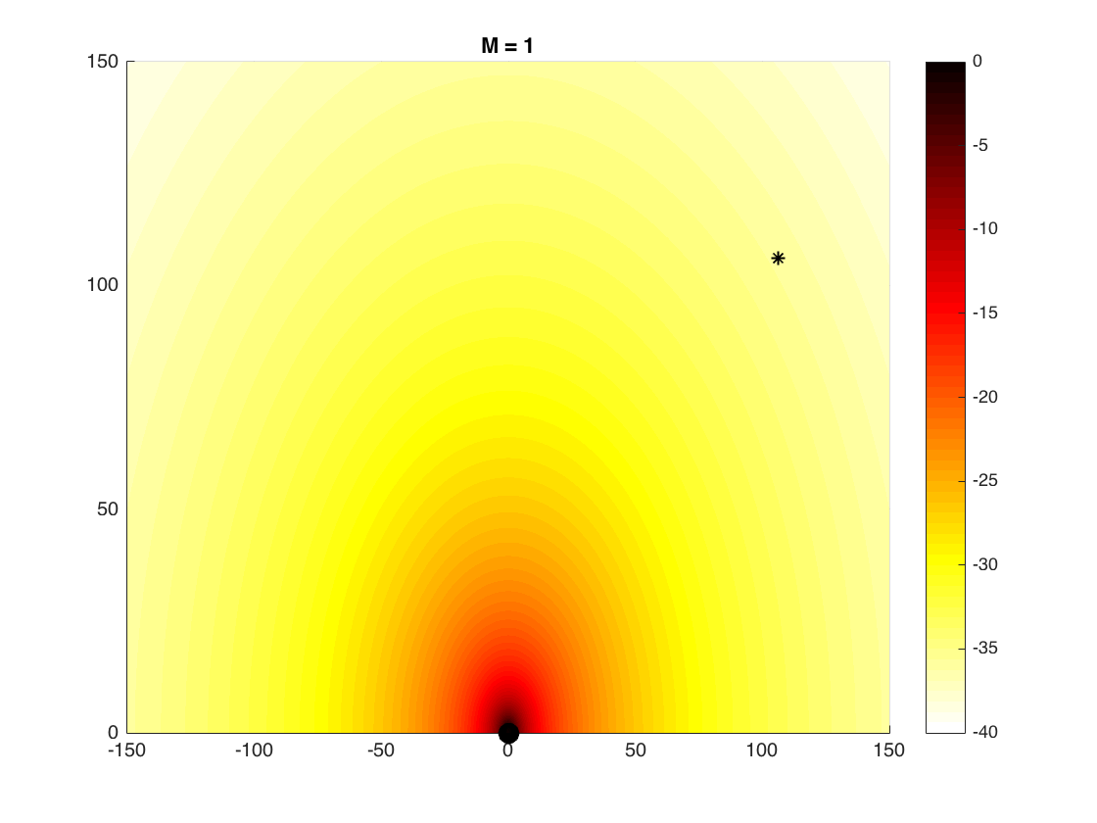
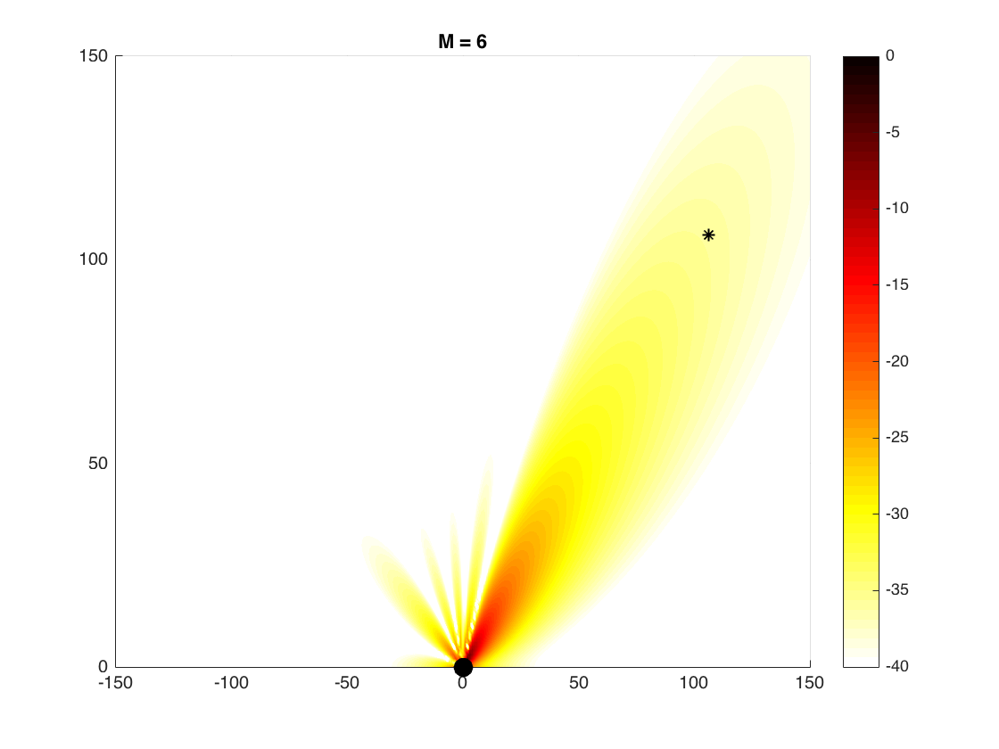
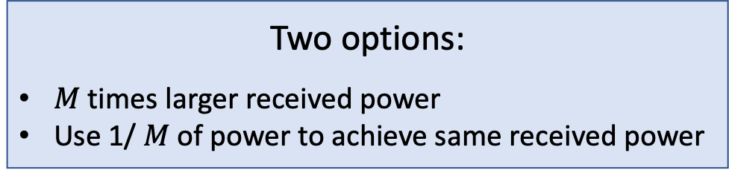
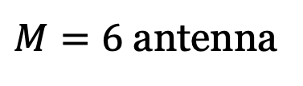
Adaptive beamforming
One antenna
Power directed towards receiver
Constructive interference
Send signals with time delays
Needs to know “direction”
We can use directivity in any band
$M=6$ antenna
Two options:
$M$ times larger received power
Use 1/ $M$ of power to achieve same received power
Beam

Slide 13
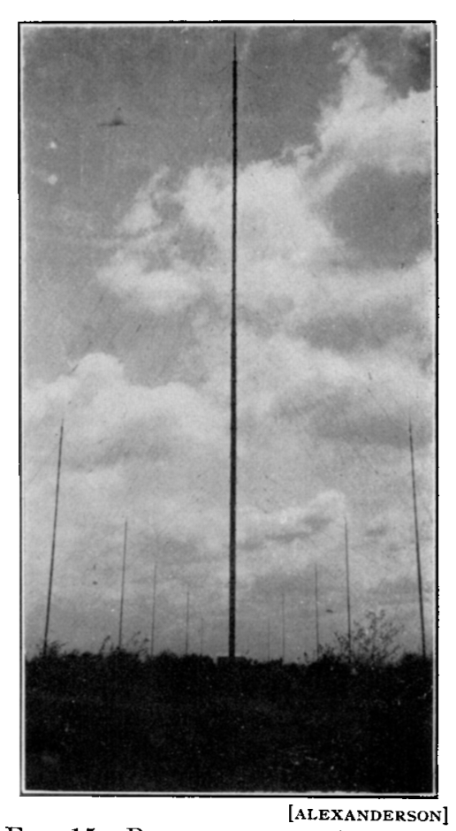
History: Beamforming
Directional communication
E.F.W. Alexanderson, ”Transatlantic Radio Communication”, Trans. AIEE, 1919.
Directive radiation pattern
Constructive/destructive interference patterns
Energy savings or better performance
Called beamforming gain

Slide 14
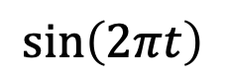
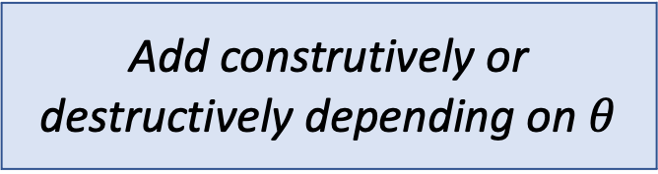
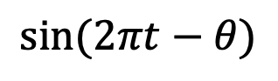
Multipath Propagation
Add construtively or destructively depending on $θ$
$$sin⁡(2πt−θ)$$
Transmitter
$$\sin\left(2πt\right)$$
Receiver
Received signal: $\sin\left(2πt\right)+\sin\left(2πt−θ\right)=2\cos\left(\frac{θ}{2}\right)\sin\left(2πt−\frac{θ}{2}\right)$
Amplitude from 2 to 0

Slide 15
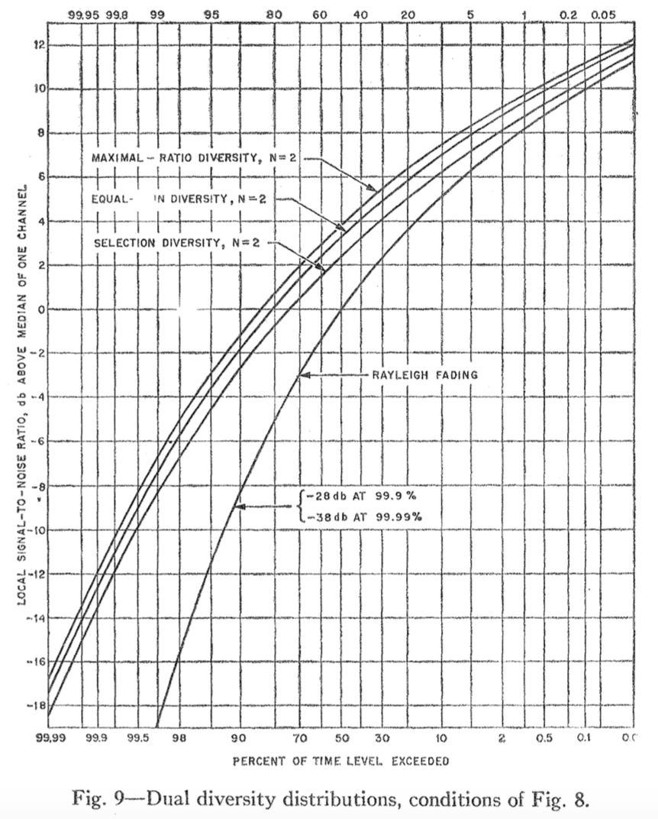
History: Spatial diversity
Diversity combining
D.G. Brennan, “Linear diversity combining techniques,” Proc. IRE, 1959
Protect against fading/noise
Multiple antennas with independent observations
Small risk multiple observations are all bad
Improve reliability
Called diversity gain

Slide 16
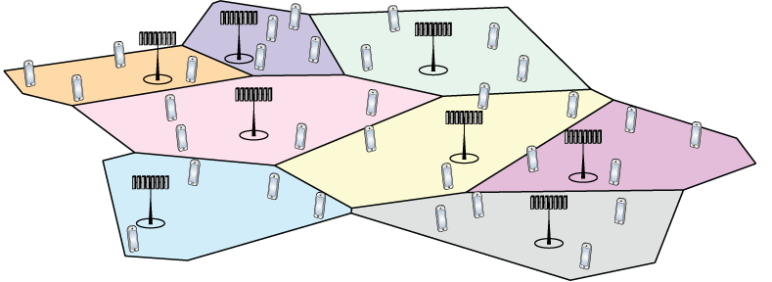
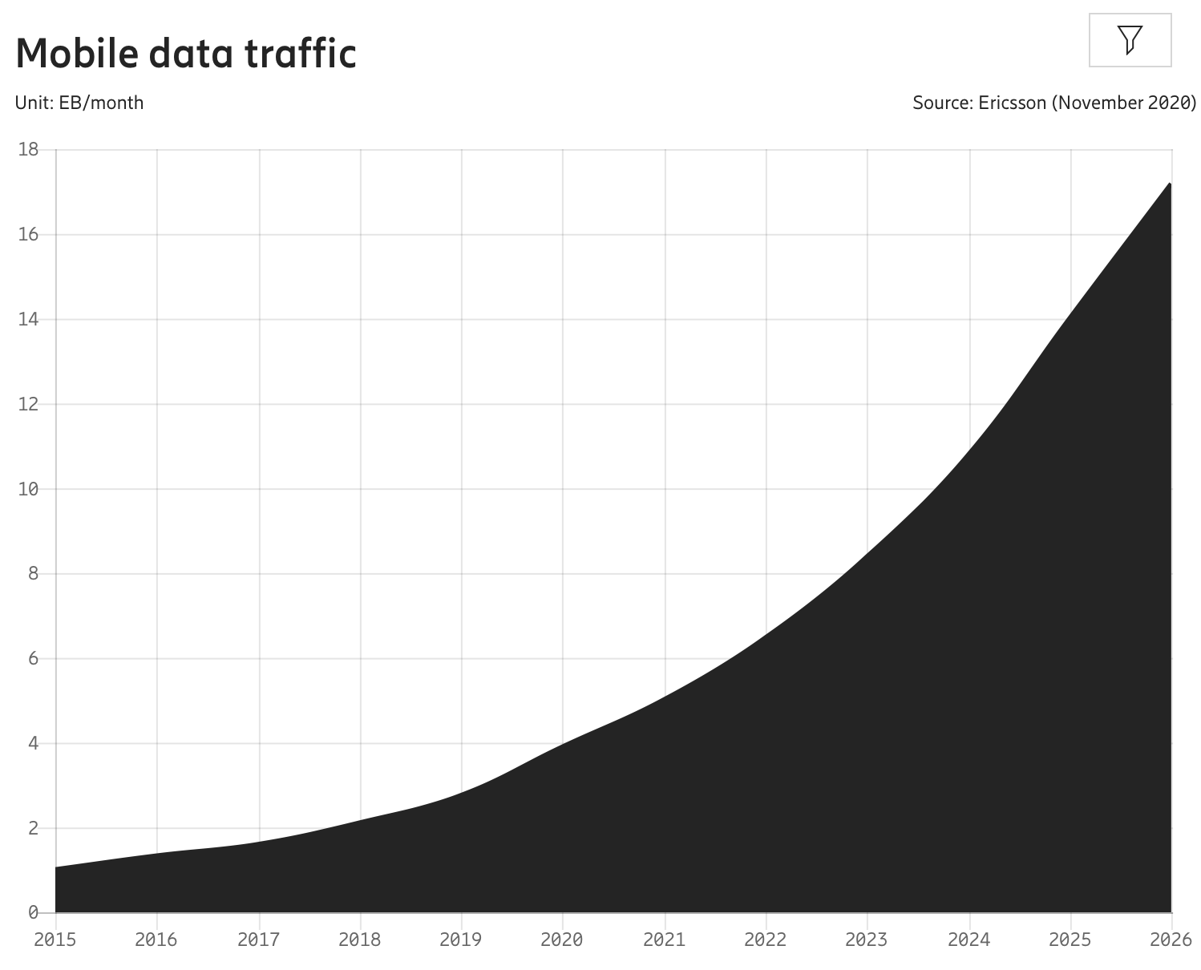
Cellular networks
Designed for mobile telephony
Bullington, K. (1953). “Frequency economy in mobile radio bands”. The Bell System Technical Journal.
Schulte, H. J. and W. A. Cornell (1960). “Multi-area mobile telephone system”. IEEE Trans. Veh. Technol.
Reuse of spectrum in space:
Densify as usage increases
Control interference by fractional spectrum reuse, power control
Mobile data traffic
in North America
Exponential growth
30% per year
Can we use multiple antennas to sustain this?

Slide 17
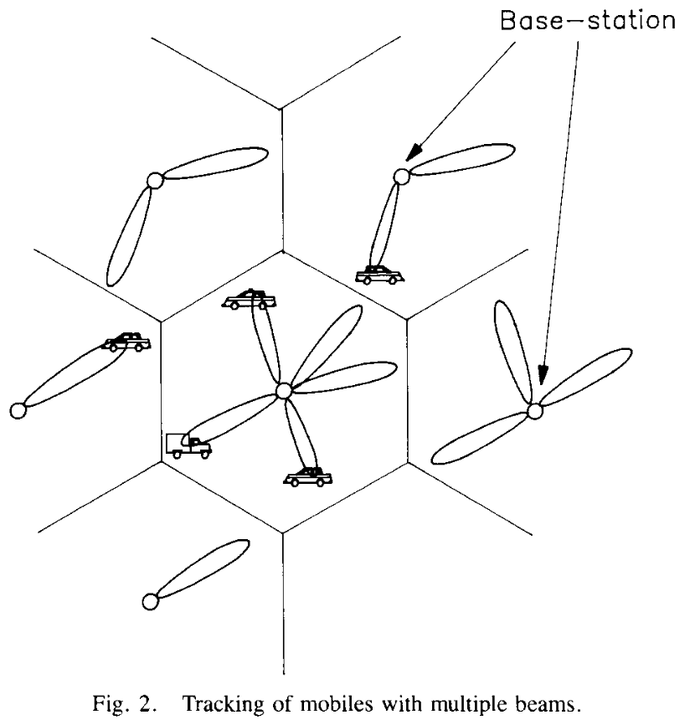
History: Space division multiple access (SDMA)
Multiple user communication
S. C. Swales et al., “The Performance Enhancement of Multibeam Adaptive Base-Station Antennas for Cellular Land Mobile Radio Systems” Trans. on Vehicular Technology, 1990.
Spatial multiplexing of users
Serve multiple users on same time and frequency
Handle more users per base station
Supported by 4G, 5G and Wi-Fi 5, 6
Called multiplexing gain

Slide 18
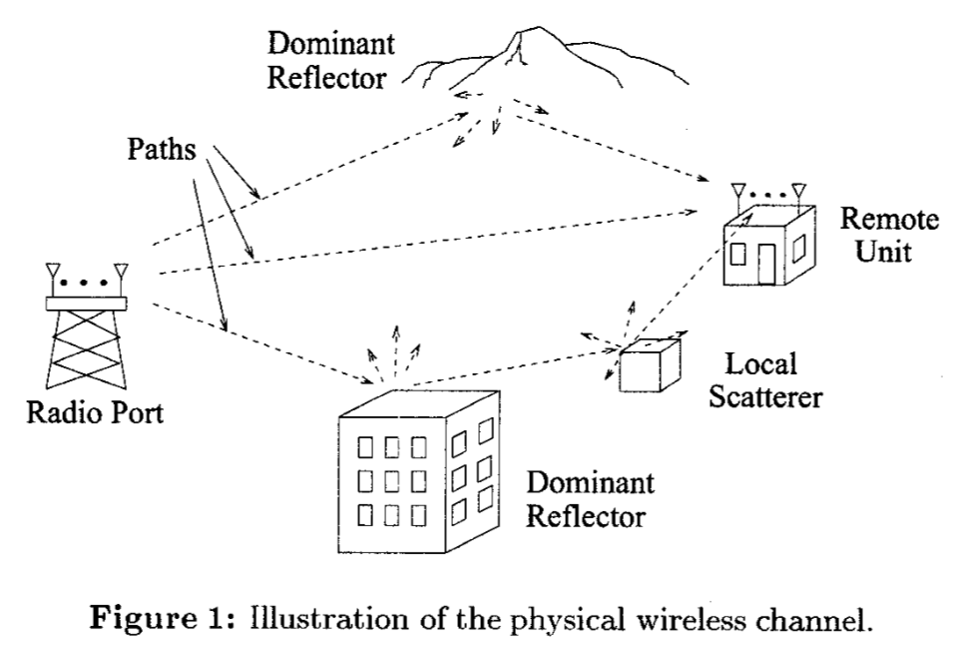
History: Point-to-point multi-antenna links
Point-to-point multiple-input multiple-output (MIMO)
G. G. Raleigh and J. M. Cioffi, “Spatio-temporal coding for wireless communications,” Globecom 1996.
Multiple streams per user
Increase capacity (bit/s) per user
Requires multiple paths
Supported by 4G, 5G and Wi-Fi 5, 6
Also called multiplexing gain

Slide 19
Outline of this course
Lecture 1:
Motivation for multiple antennas
History of multiple antenna communications
Basic multi–antenna channels (Lecture 2)
Diversity and ergodic capacity (Lecture 3)
Point-to-point MIMO (Lecture 4)
Multi-user MIMO (Lectures 5-12)
Capacity bounds, Channel estimation, Power control, etc.
Based on the manuscript:
“Introduction to Multiple Antenna Communications”
Based on the book
“Fundamentals of Massive MIMO”

Slide 20
Summary
Mobile communications require multiple antennas
Adaptive directive transmission (beamforming gain)
Mitigate channel fading (diversity gain)
Increase data rates (multiplexing gain)
Useful in low-band, mid-band, and high-band spectrum

Slide 21
Multiple Antenna Communications
Lecture 1:
Motivation for Multiple Antenna Communications
Emil Björnson

